Slide 1
Correlation between Venues in Toronto Neighborhoods and Covid-19 Transmission

Slide 2
2020 – A special year
World wide Covid-19 has infected over 84.8 millions of people and caused 1.84 million deaths
Till December 30, 2020 there are totally 572982 Covid-19 cases and costed 15472 lives in Canada
Ontario has the second highest total cases (178831) among all provinces and Toronto has 60000 cases since the beginning of pandemic.
Is there any correlation between venues in Toronto neighborhoods and Covid-19 transmission?

Slide 3
Data Source and Cleaning
Statistics of Covid-19 cases in Toronto as of Dec 22 from www.toronto.ca
Assign preferable feature names
Calculate population of each neighborhood
GEOJSON file for neighborhoods in Toronto from https://open.toronto.ca/dataset/neighbourhoods/
Extract coordinates and area of each neighborhood
Calculate coordinate and area of each neighborhood
Combine above to datasets into ‘toronto_data’
Calculate radius of circle with equivalent area of neighborhood to pass to Foursquare

Slide 4
Explore Neighborhoods in Toronto
Obtain venues in each neighborhood from Foursquare
Perform EDA on venues
There are 328 different venue categories and quite a few has quantity of 1 or 2
Since neighborhoods have various of sizes, it makes sense to normalize number of venues with the area of neighborhood
Group venue categories into bigger categories
Normalize number of venues with the area of neighborhood

Slide 5
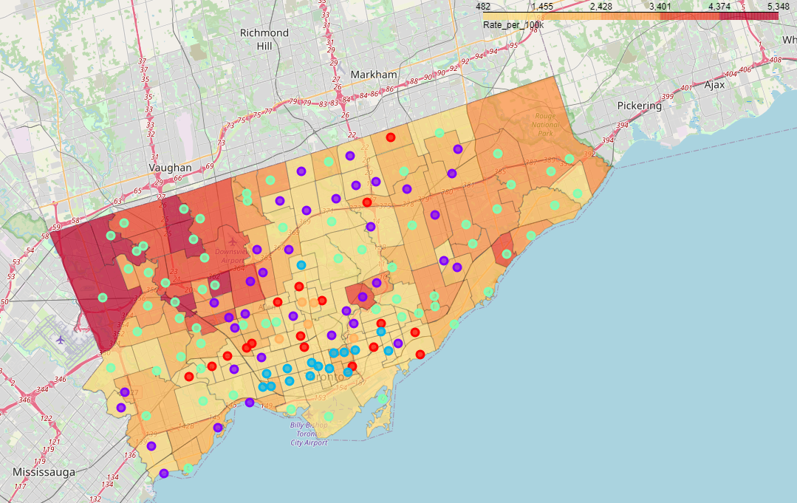
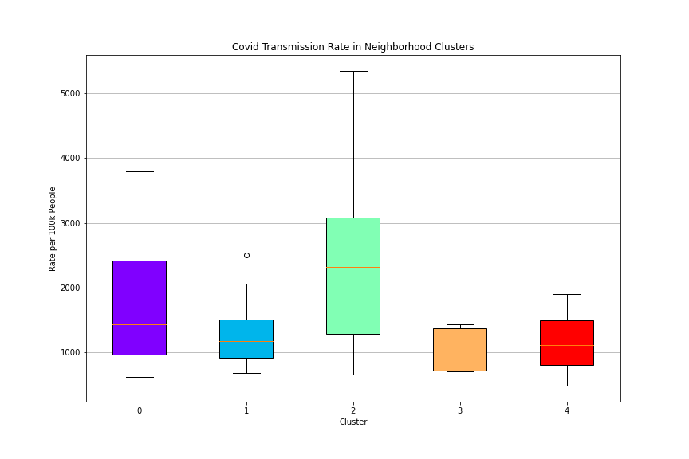
Neighborhood Clustering
Green and purple clusters happen to have higher transmission rate. They are located outside the core area of Toronto.

Slide 6
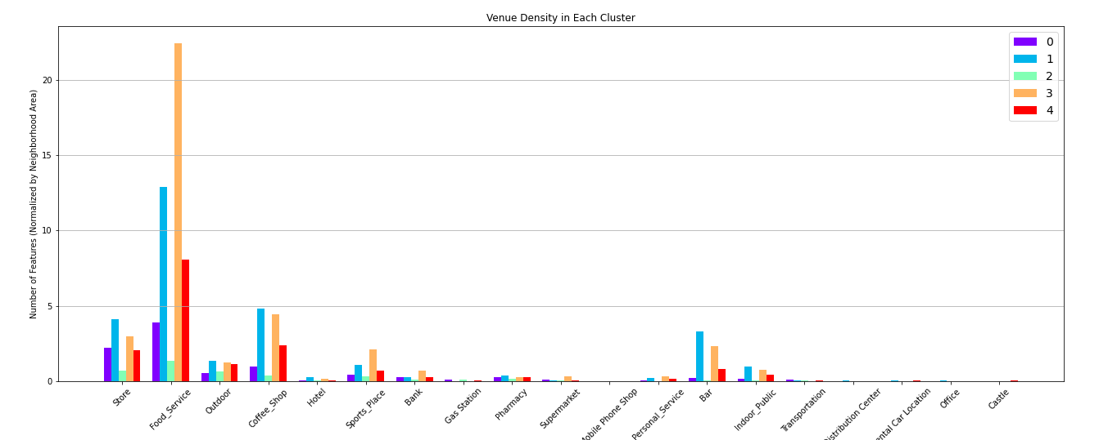
Venues in Each Cluster
Interestingly cluster green or purple does not have any venue that has significant higher density than other three clusters. In fact, cluster blue and yellow have very high venue density in food service, stores, coffee shops and bars because they are at the core of city.

Slide 7
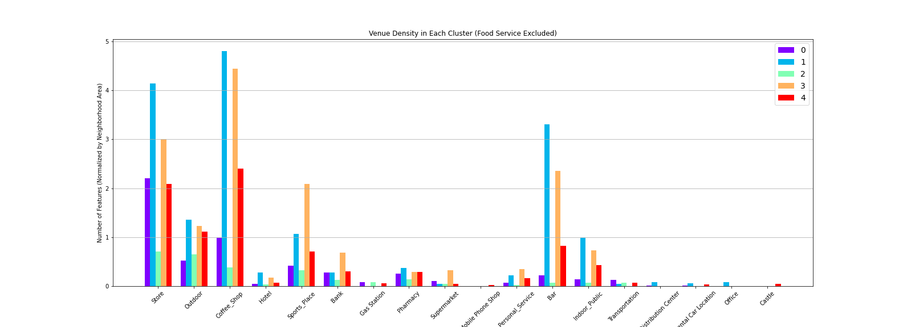
Venues in Each Cluster (Food Service Excluded)

Slide 8
Conclusion
We did not find strong correlation between venues in neighborhood and Covid-19 transmission rate
However we have to keep in mind that:
We used circle of equivalent area as boundary of neighborhood instead of the real boundary.
Foursquare limited number of venues per API call to 50. Therefore for each neighborhood we can only obtain 50 venues.

